Slide 1
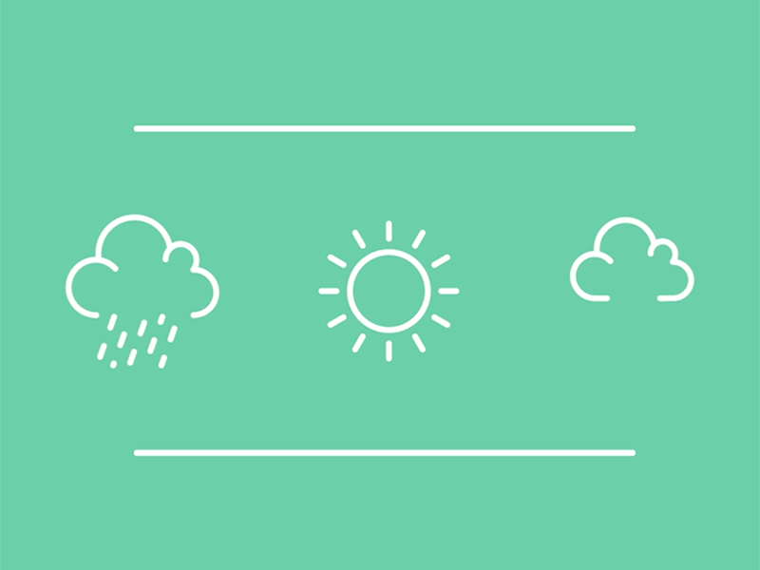


Magnificent Meteorology
Presented by:
In partnership with:

Slide 2
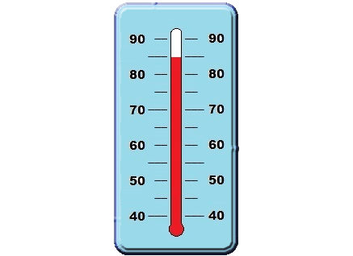
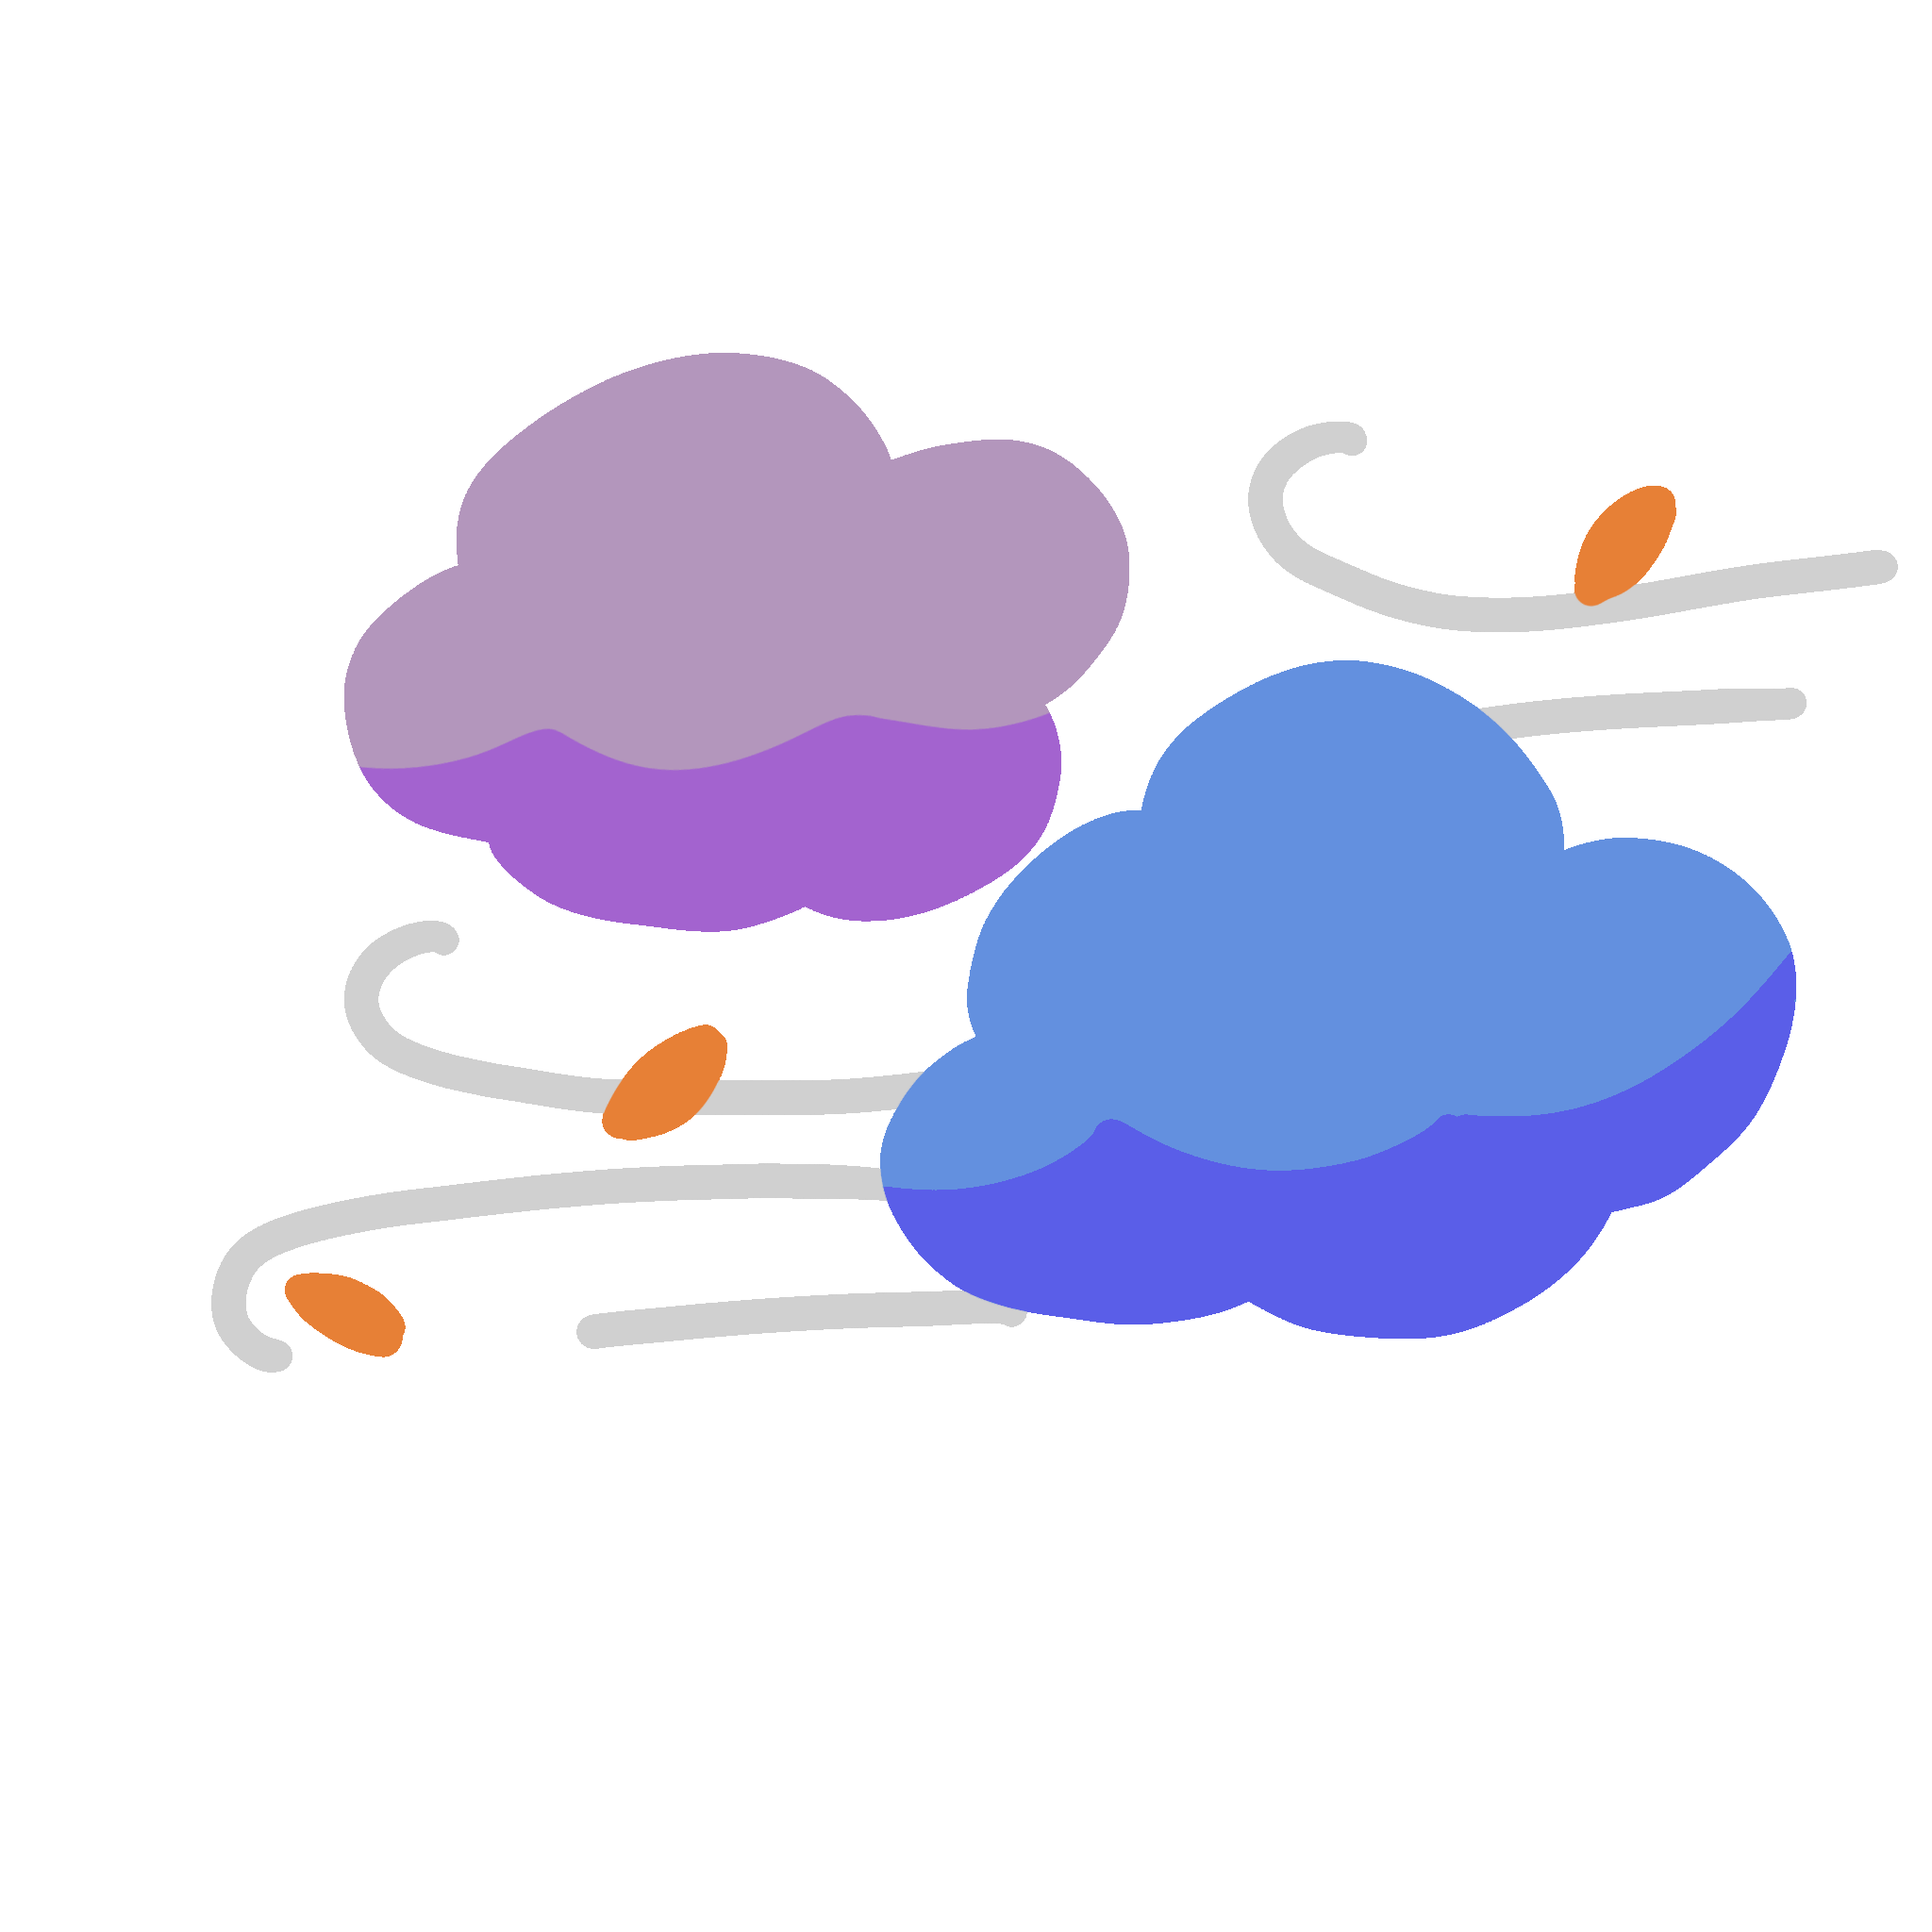

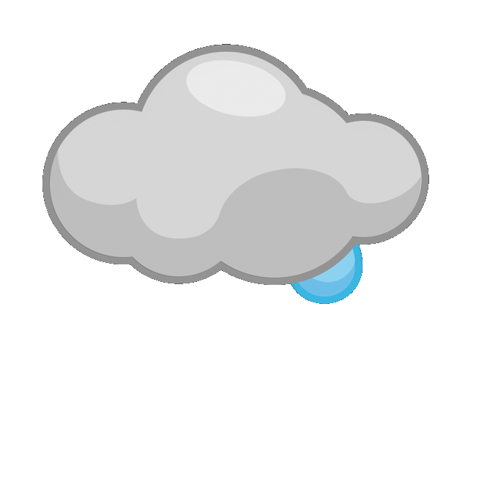

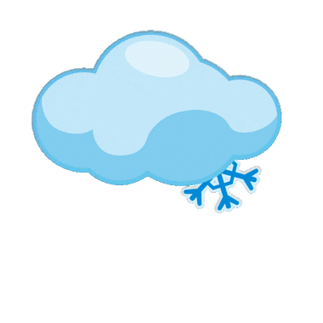
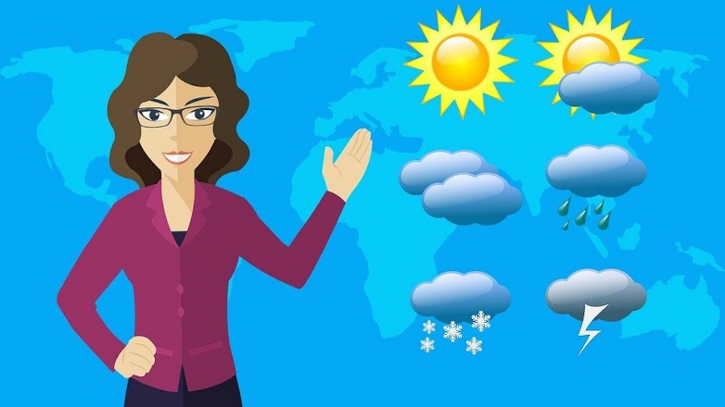
Weather
Weather describes the temperature, wind, sunlight, clouds, and precipitation at a certain place and time.
Different places in the world have different types of weather.
Meteorology is the study of weather, weather conditions, and how to forecast the weather.
A meteorologist is a scientist who studies and predicts the weather.

Slide 3
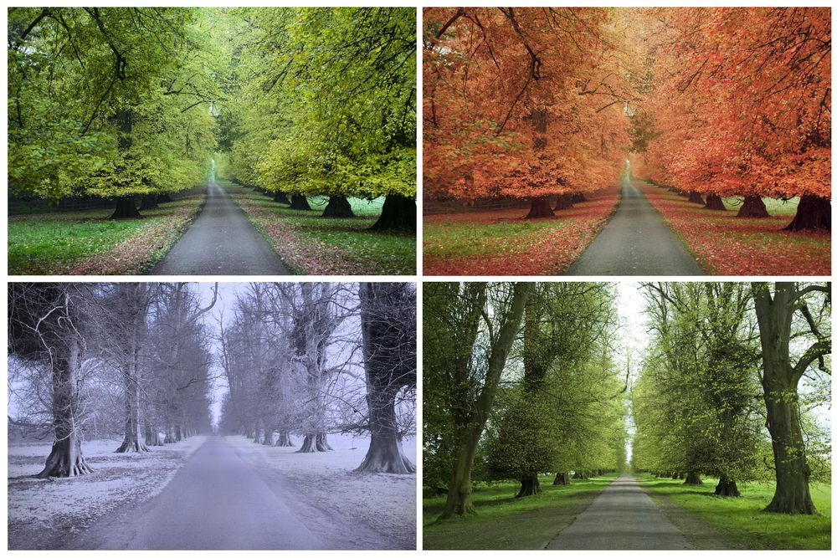
Seasons
The weather changes each season.
Spring (March, April, May)
Temperatures start warming up
Rain
Trees begin to grow leaves
Plants start to flower
Summer (June, July, August)
Hot temperatures
Humid air (moisture)
Thunderstorms
Trees have full green leaves
Fall/Autumn (September, October, November)
Cooler temperature
Rain
Changing/falling leaves
Winter (December, January, February)
Cold temperatures
Sometimes get snow and frost
Most trees don’t have any leaves

Slide 4
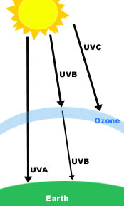
Sun and Atmosphere
The Sun is responsible for most of the Earth's weather, even though it is about 93 million miles away. The Sun’s heat gives energy to the Earth's atmosphere, creating the weather patterns.
The atmosphere is a layer of air around the Earth that plants, animals, and people breathe.
There are ways to trap the energy from the Sun and use it as an electrical energy source. This is called solar power.
The Sun gives off ultraviolet light (UV), a type of invisible light, in UV-A, UV-B, and UV-C rays. Since the atmosphere’s ozone layer absorbs most of the UV rays, 99% of the ultraviolet light that reaches the Earth's surface is UV-A. Sunscreen helps keep you safe from getting burned by UV light.

Slide 5
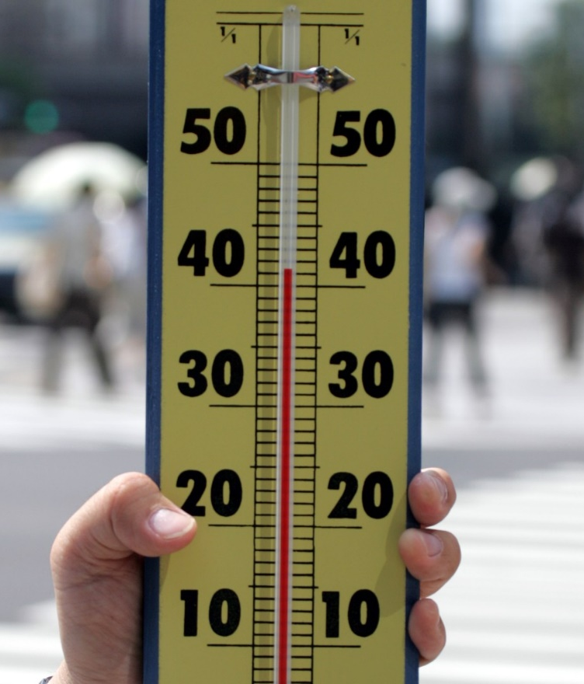
Temperature
Temperature describes how hot or cold the air is. Temperatures change all the time.
A thermometer is used to measure the temperature.
Some temperature changes happen quickly while others can be slow and hard to notice.
Do you feel a change in temperature if you sit in the shade after playing in the sun?
Thermometer

Slide 6
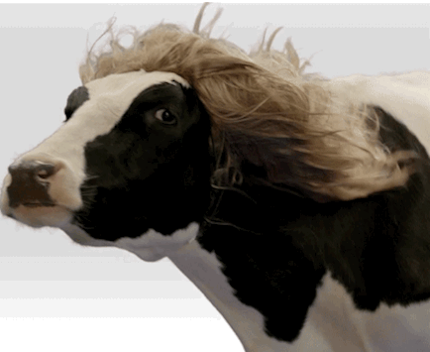
Wind
Wind is the result of air moving around in the atmosphere.
As the Sun warms up the Earth's surface, the atmosphere warms up, as well. On the Earth, there is always an area of low pressure at the poles where the air is always cold. There is also higher pressure at the equator where the air is hot. The warm air begins to rise up because it weighs less than cold air. When cool air moves in and replaces the rising warm air, the movement makes the wind blow. These two major areas of air pressure keep the wind constantly moving about the Earth.
The spin of the Earth also affects the direction of winds. This is called the Coriolis Effect.
Meteorologists use two main measurements to describe wind: direction and speed.

Slide 7
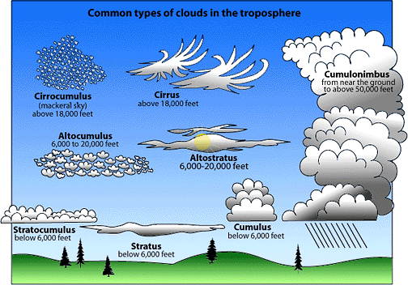
Clouds
Clouds are a visible collection of tiny water droplets or, at colder temperatures, ice crystals floating in the air above the surface.
Clouds come in many different sizes and shapes.
Clouds can form at ground level (fog), at great heights in the atmosphere, and everywhere in between.
Clouds give important clues to understanding and forecasting the weather.

Slide 8

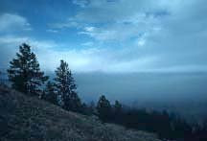
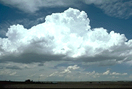
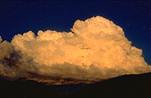
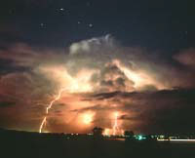
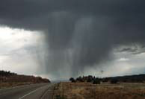
Low Level Clouds
Stratus clouds are a uniform, grayish color that often cover the entire sky. They look like fog that does not reach the ground. Usually, no precipitation falls from stratus clouds, but sometimes they may drizzle. These clouds lie below 6,000 feet.
Cumulus clouds are usually puffy clouds that can look like pieces of floating cotton. The base of each cloud is usually flat and may be only 330 ft above the ground, and the top has rounded towers. When the top of the cumulus looks like the head of a cauliflower, it is called a towering cumulus.
Cumulonimbus clouds form if cumulus clouds continue to grow vertically. Their dark bases may be at no more than 1,000 ft., but their tops may get up to over 50,000 ft. Huge amounts of energy are released by a cumulonimbus. Lightning, thunder, and even tornadoes are associated with the cumulonimbus.

Slide 9

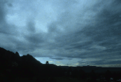

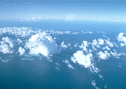
Middle Level Clouds
Altostratus clouds are gray or blue-gray clouds made of ice crystals and water droplets. They usually cover the entire sky. In the thinner areas of the cloud, the sun may be dimly visible. Altostratus clouds usually form ahead of storms that create nonstop precipitation.
Altocumulus clouds are made of water droplets and appear as gray, puffy masses, sometimes rolled out in waves or bands. Seeing these clouds on a warm, humid summer morning can mean thunderstorms may occur by late afternoon. These clouds usually have bases between 6,000 and 20,000 ft.

Slide 10

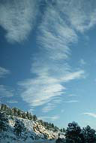

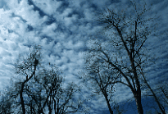
High Level Clouds
Cirrus clouds are thin, wispy clouds blown by high winds into long streamers. They usually form above 18,000 ft. Cirrus clouds usually move across the sky from west to east. They usually mean fair to pleasant weather.
Cirrocumulus clouds appear as small, rounded white puffs. The small ripples in the cirrocumulus sometimes resemble the scales of a fish. A sky with cirrocumulus clouds is sometimes referred to as a "mackerel sky." The bases of these clouds usually form above 18,000 ft.

Slide 11
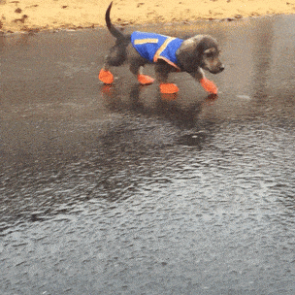
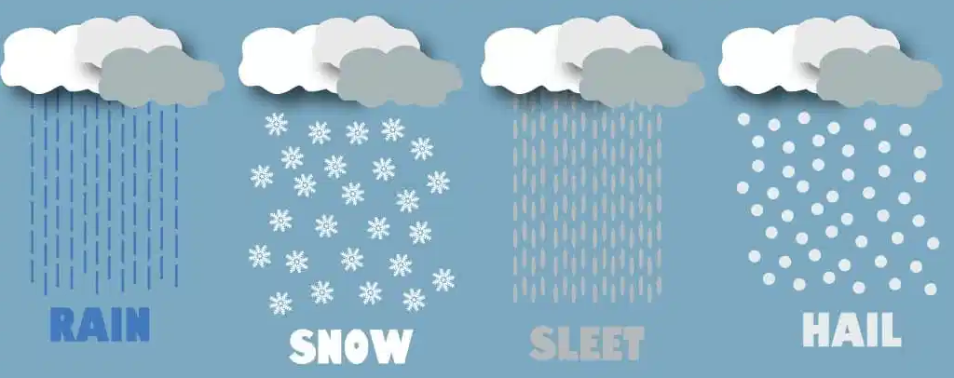
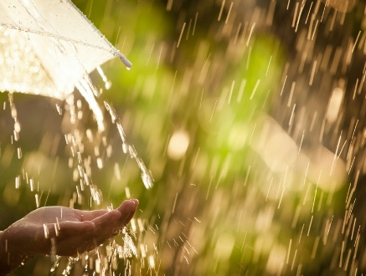
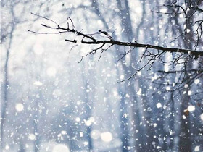
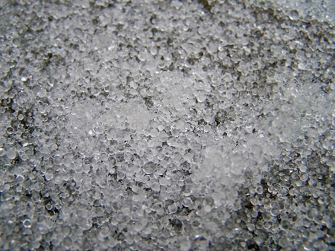
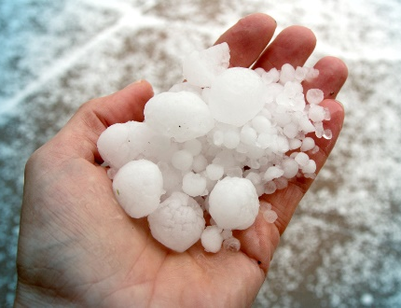
Precipitation
Any type of water that falls from clouds is called precipitation.
When clouds get too full, water droplets bump together creating bigger water droplets that are too heavy for the cloud to hold.

Slide 12
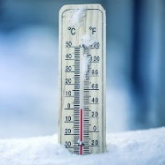
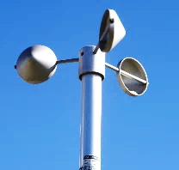
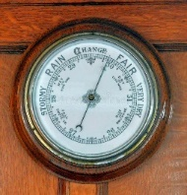
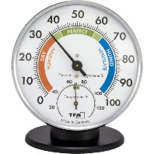
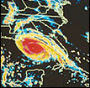
Weather Instruments
Thermometer - An instrument that measures how hot or cold the air temperature is at the time.
Anemometer - A weather instrument that measures the wind speed.
Barometer - An instrument that measures air pressure.
Hygrometer - An instrument that measures the humidity, or water vapor content of the air.
Radar - An electronic instrument that determines the direction and distance of objects that reflect radio energy back to the radar site. This is what meteorologists use to see rain or snow.

Slide 13
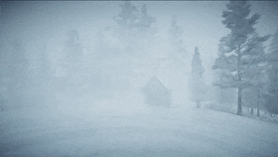
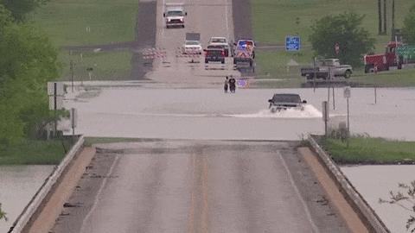
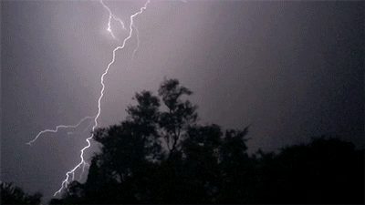
Severe Weather
Blizzards are strong winter storms with winds of 35 miles per hour or more. They have falling and/or blowing snow that reduces visibility to less than 1/4 mile for at least three hours.
Flash floods occur when water rises quickly with no warning within several hours of an intense rain. They may take place after heavy rainfall from slow moving thunderstorms.
Thunderstorms are produced by cumulonimbus clouds and have lightning and thunder. Heavy rain, hail, and high winds may occur in some cases.

Slide 14
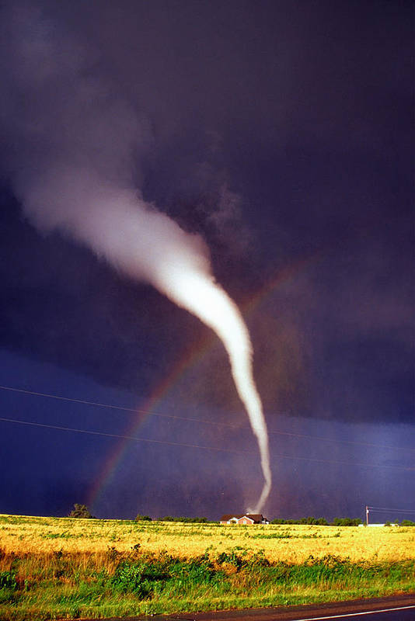
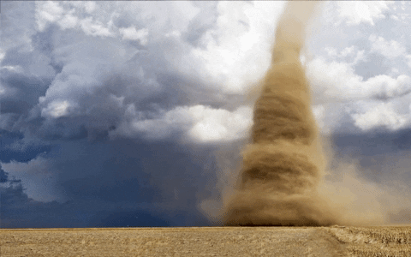
Tornadoes
Tornadoes begin as a funnel cloud with spinning columns of air that drop down from a severe thunderstorm. When they reach the ground they become tornadoes.
Tornadoes are formed by instability in the atmosphere due to the mixing of warm, moist air and cool, dry air. The wind changes direction and increases in speed creating an invisible, horizontal spinning effect in the lower atmosphere.
Tornadoes can be between 300-2,000 feet wide and travel at wind speeds between 20-300 mph.
Tornadoes are measured on a scale called the Fujita Pearson Tornado Scale which ranks them from 0 to 5 based on winds and damage.

Slide 15
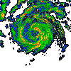
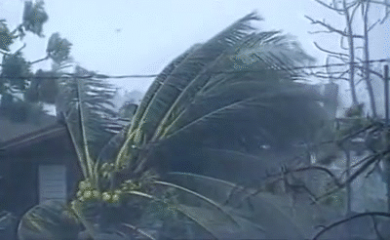
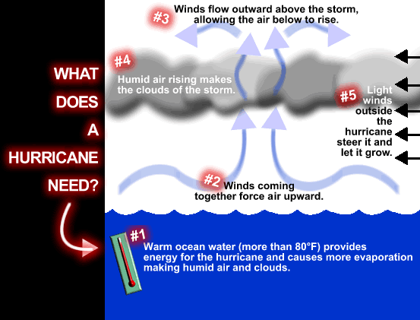
Hurricanes
Hurricanes are intense storms with swirling winds of up to 150 mph and are usually 300-600 miles across.
Hurricanes usually last for over a week, moving 10-20 mph over the open ocean.
Hurricanes gather heat and energy through contact with warm ocean waters.
Hurricanes rotate in a counter-clockwise direction in the northern hemisphere, the opposite of a clock. In the southern hemisphere, hurricanes rotate clockwise.
The center of the storm or "eye" is the calmest part. The “eye” has light winds and fair weather.

Slide 16
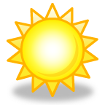

Rainbows
Sunlight looks white, but it's really made up of different colors...red, orange, yellow, green, blue, indigo, and violet.
Rainbows form when white sunlight passes through rain drops. The raindrops act like tiny prisms. They refract (bend) the different colors in white light, so the light spreads out into a band of colors and is reflected back to you as a rainbow.
Three conditions must be met in order for you to see a rainbow.
It must be raining.
The sun must be shining.
The observer must be between the sun and the rain. The lower the sun is in the sky, the higher the arc of the rainbow will be.
Sun
Rain
Rainbow
Observer

Slide 17
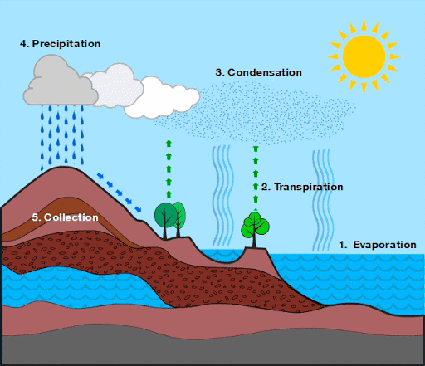
The Water Cycle
The world’s water moves between lakes, rivers, oceans, the atmosphere, and the land in an ongoing cycle called – you guessed it! – the water cycle. As it goes through this continuous system, it can be a liquid (water), a gas (vapor), or a solid (ice).
1. Evaporation
Energy from the sun heats up the surface of the Earth, causing the temperature of the water to rise. Some of the water evaporates into the air, turning into a gas called vapor.
2. Transpiration
Plants and trees also lose water to the atmosphere through their leaves.
3. Condensation
As water vapor rises up high into the sky, it cools and turns back into a liquid, forming clouds. This process is called condensation. Currents high up in the air move these clouds around the globe.
4. Precipitation
When too much water has condensed, the water droplets in the clouds become too big and heavy for the air to hold them. Then they fall back down to Earth as rain, snow, hail, or sleet in process known as precipitation.
5. Collection
The fallen precipitation is then “collected” in bodies of water – such as rivers, lakes, and oceans – from where it will eventually evaporates back into the air, beginning the cycle all over again.

