Slide 1



Magnificent Meteorology
Presented by:
In partnership with:

Slide 2
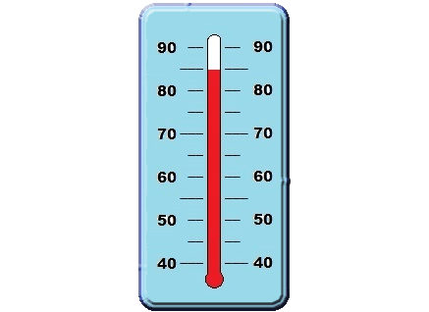


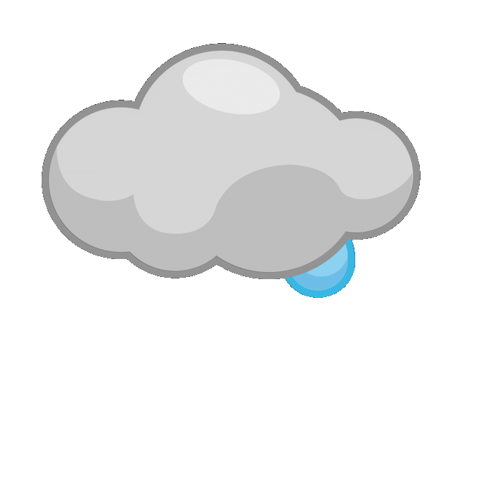

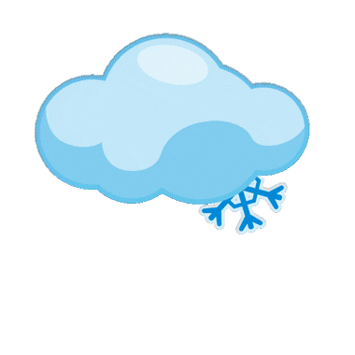
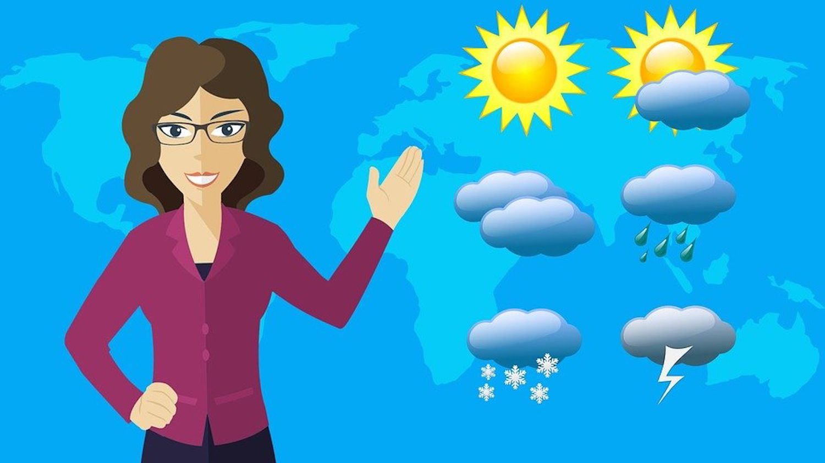
Weather is…
Hot or Cold?
(temperature)
Wind
Sunlight
Clouds
Rain or Snow (precipitation)
A meteorologist studies and forecasts weather.

Slide 3
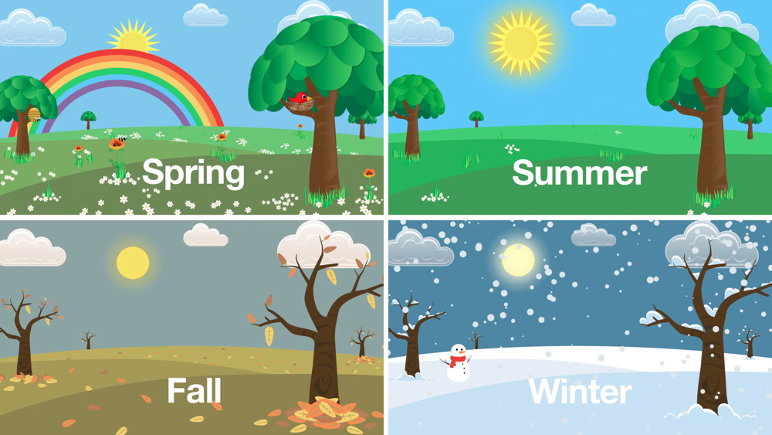
Seasons
The weather changes each season.

Slide 4
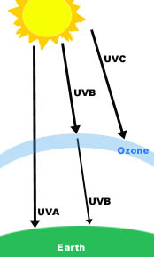
Sun and Atmosphere
The Sun causes most of the Earth's weather.
The Sun’s heat gives energy to the Earth's atmosphere and creates weather.
The atmosphere is a layer of air around the Earth that plants, animals, and people breathe.
The Sun gives off ultraviolet light (UV) a type of invisible light. Sunscreen helps keep you safe from getting burned from UV light.

Slide 5
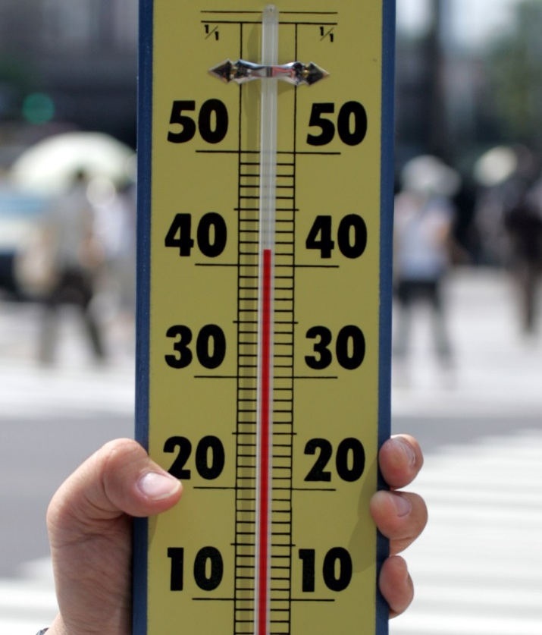
Temperature
Temperature describes how hot or cold the air is.
A thermometer is used to measure the temperature.
Do you feel a change in temperature if you sit in the shade after playing in the sunshine?
Thermometer

Slide 6
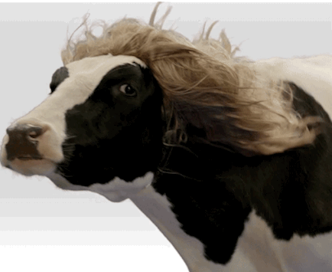
Wind
Wind is air moving in the atmosphere.
When cool air replaces warm air it makes the wind blow.
Sometimes you can hear the wind move or feel it blow on your face.
You can’t see wind, but you can see how it moves other things like the leaves and branches of trees.

Slide 7
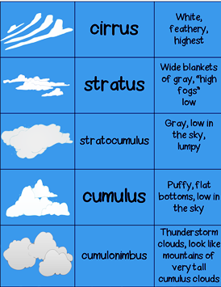
Clouds
Clouds are a collection of water droplets.
Clouds come in many different sizes and shapes.
Clouds help forecast the weather.

Slide 8
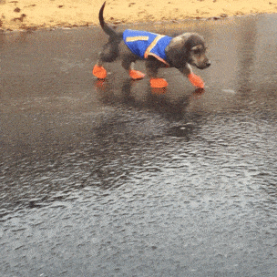
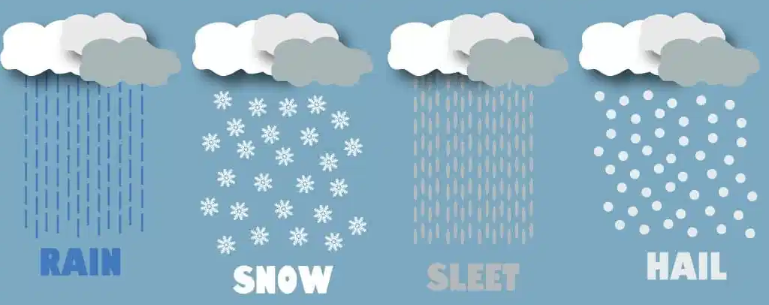
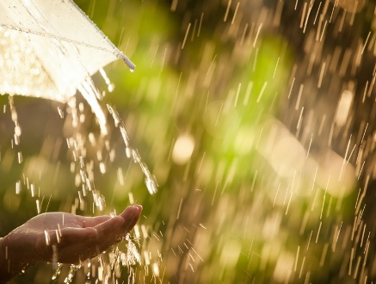
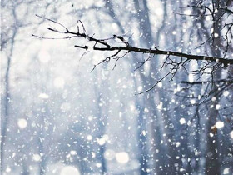
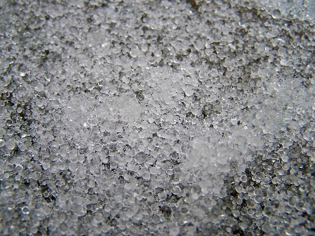
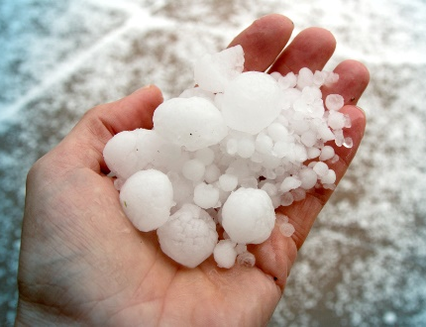
Precipitation
Any type of water that falls from clouds is called precipitation.

Slide 9
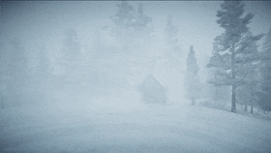
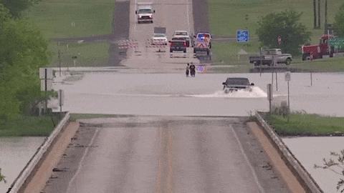
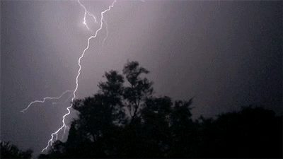
Severe Weather
Blizzards are strong winter storms with blowing snow.
Flash floods happen when water rises very quickly after heavy rain.
Thunderstorms create lightning and thunder.

Slide 10
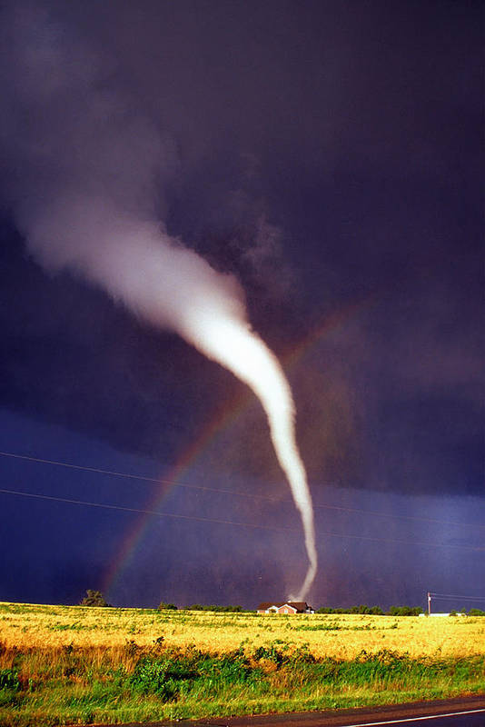
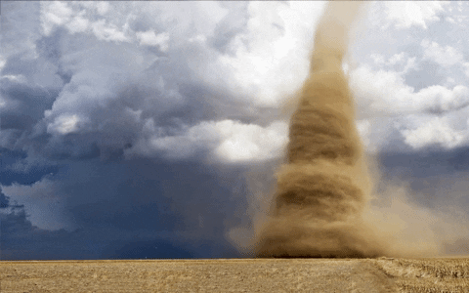
Tornadoes
Tornadoes are spinning funnels of air that stretch from the storm in the sky to the ground below.

Slide 11
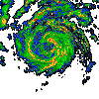
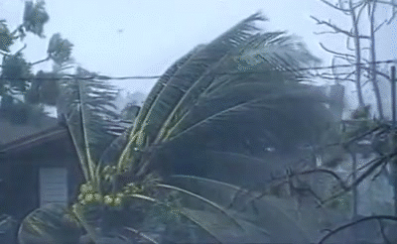
Hurricanes
Hurricanes are large storms over ocean water with strong swirling winds.
Hurricanes near the United States spin the opposite way of a clock.
The center of the storm or "eye" is the calmest part.

Slide 12


Rainbows
Sunlight looks white, but is made up of red, orange, yellow, green, blue, indigo, and violet.
Rainbows are made when sunlight shines through rain drops.
The raindrops bend the different colors in white light. The light spreads out into a band of colors you see as a rainbow.
Sun
Rain
Rainbow
You

Slide 13


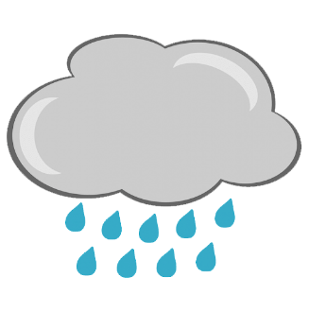

The Water Cycle
Water follows a pattern that repeats over and over called the water cycle.
Condensation
Water droplets make new clouds.
Evaporation
Sunshine “evaporates” some of the water droplets.
Precipitation
Rain or snow comes down from the clouds.
Collection
Rain water makes puddles and adds water to lakes, rivers, and oceans.

Slide 14
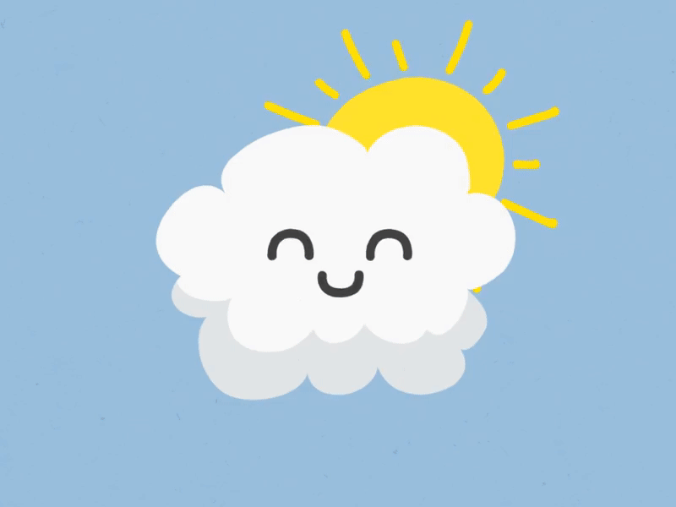
Weather Songs
Eensy Weensy Raindrops (Tune: Eensy, Weensy Spider)
Some eensy, weensy raindrops
Are falling from the sky.
They're filling up the puddles
And dropping in my eye.
Drip, drip and drop, drop,
I love to hear them fall,
For the eensy, weensy raindrops
Mean wet fun for us all.
What's the weather? (Tune: Clementine)
What's the weather? What's the weather?
What's the weather like today?
Tell me children what's the weather?
What's the weather like today?
Is it sunny, is it rainy, is it windy out today?
Tell me children, what's the weather, what's the weather like today?
The Weather One Day
One day the sun was shining bright, (hold up right hand for the sun)
But some clouds came along and it became black as night. (Hold up left hand for the clouds)
Then the rain began to sprinkle onto the ground, (wiggle fingers for the rain coming down)
And soon it was raining all over the town.
But when the clouds had passed on by, (move both hands to the right)
A big beautiful rainbow stretched across the sky. (have your left hand make a rainbow arc over your head)

