Slide 1
Polymers
Chains of repetition…
Presented by:
In partnership with:

Slide 2
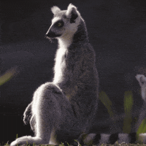
What’s in a name?
Polymers, not Paul Lemur, are what we are talking about!
Poly– means many
–mer means parts
So the word polymer means it is made of many parts.
“Who you callin’ Paul Lemur?”

Slide 3
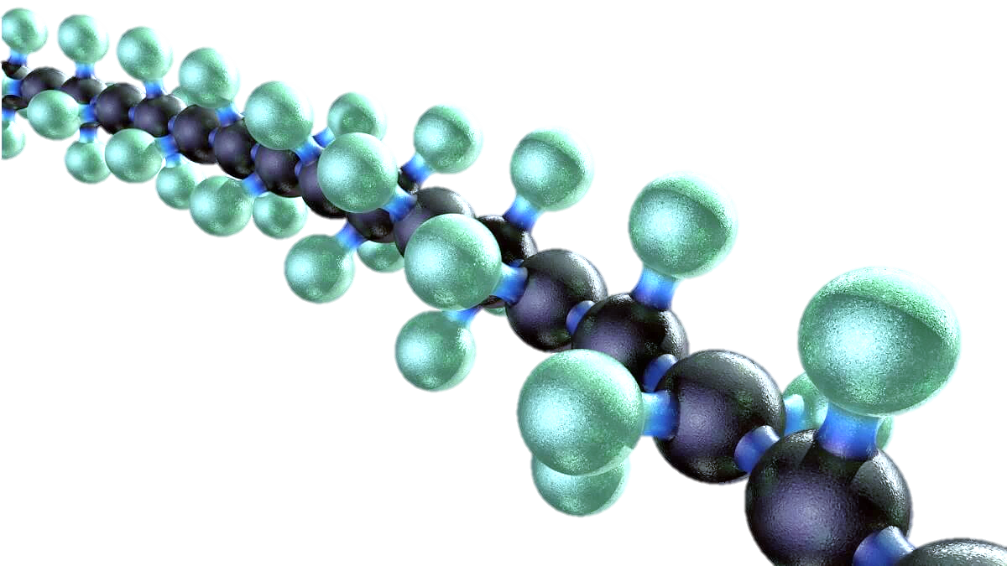
What is a Polymer?
Polymers are molecules that are made of chains of individual units called monomers, just like the long chain of a bike is made of individual links.
A single polymer molecule is made of hundreds or thousands (or millions) of monomers! Wow, that's a lot!
Chains of polymers can be cross-linked together to get different properties.

Slide 4
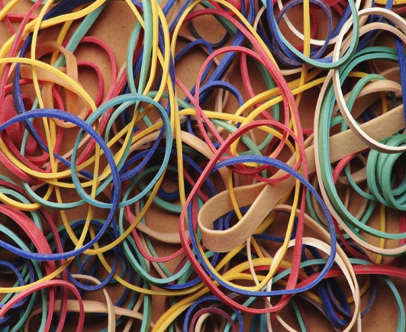
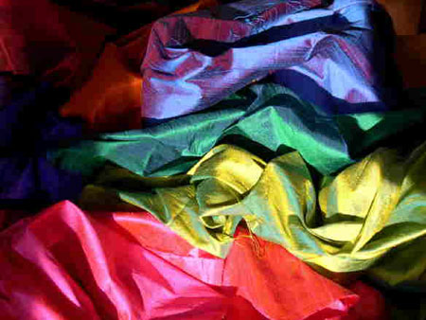
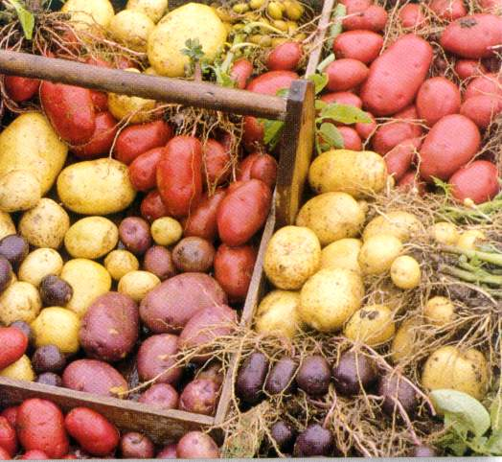
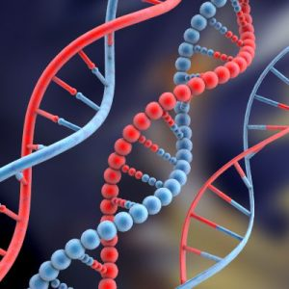
Polymers are Everywhere!
Contact lenses
Cotton
Diapers
DNA
Hair
Polyester
Potatoes
Rubber bands
Sand
Silk
Starch
Styrofoam
Teflon
Wool

Slide 5
Types of Polymers
Natural
Polymers:
These occur naturally and are found in plants and animals. A few examples of natural polymers include proteins, starch, cellulose, and rubber.
Synthetic Polymers:
These are man-made polymers. Plastic is the most common and widely used synthetic polymer. It is used in industries and various dairy products.
Semi-synthetic Polymers:
These are created from naturally occurring polymers and undergo further chemical modification. Cellulose nitrate, cellulose acetate, and vulcanized rubber are a few examples of semi-synthetic polymers.

Slide 6
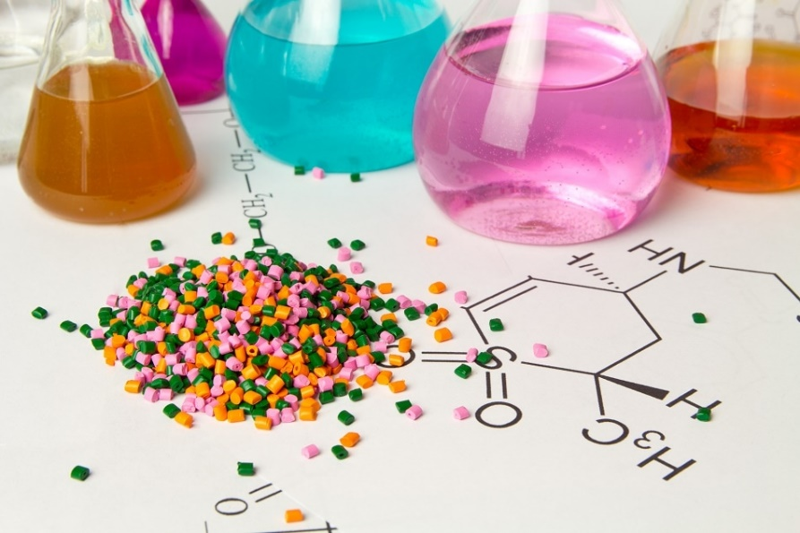
Polymer Properties
Some polymers are rubbery like a bouncy ball.
Some polymers are sticky and gooey like slime.
Some polymers are hard and tough like a skateboard.

Slide 7
Polymer Chains
Polymers are tightly bonded to each other with many chains stacked on top of each other.
When polymer chains are pulled, they can slide over each other and decrease the number of chains in a section without breaking the chains.
If pulled in the opposite direction, the chains realign.

Slide 8
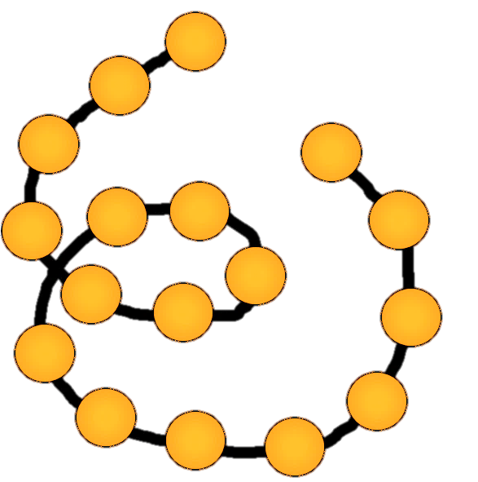
Linear Polymer Chains
Most of the polymers you will learn about are linear polymer chains. A linear polymer chain is made up of one molecule after another, hooked together in a long chain called the backbone.
Linear polymers aren’t necessarily in a straight line. The bonds between monomers in the backbone can swivel around like paper clips that are hooked together end-to-end.
A linear polymer chain starts at the beginning and runs straight to the end without branching off. You can trace the entire path from one end to the other.
Typically, linear means "straight and not curved" but for polymers, linear means "not branched".

Slide 9
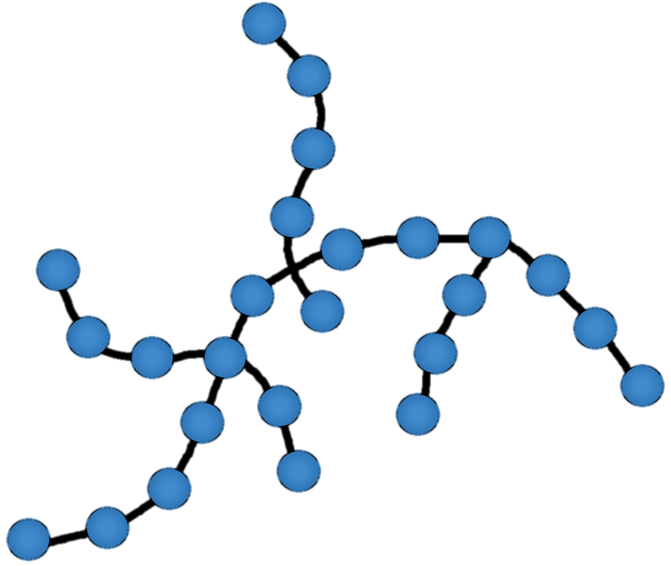
Branched Polymer Chains
A branched polymer chain has extra beginnings (or branches) along the chain and has lots of ends.
No matter where you start, you cannot trace the entire polymer chain without backtracking.

Slide 10
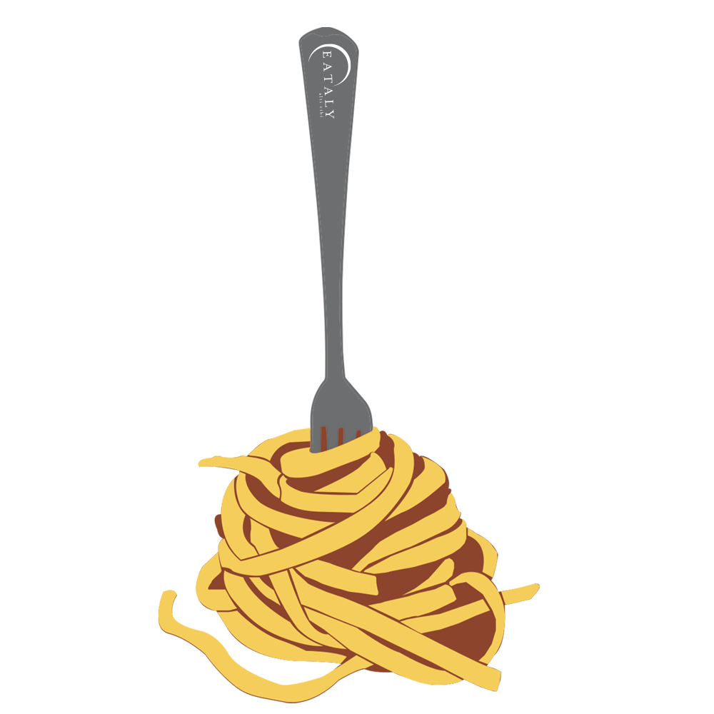
Polymer Chain Tangles
The longer a polymer chain is, the more tangled up it can get. Tangled chains are harder to distort or separate, so they can be used to produce stronger materials.
Some polymers are more straight and stiff than others. These will not tangle up as much, but they are strong for a different reason - stiff chains can stack tightly together and stick to each other.

Slide 11
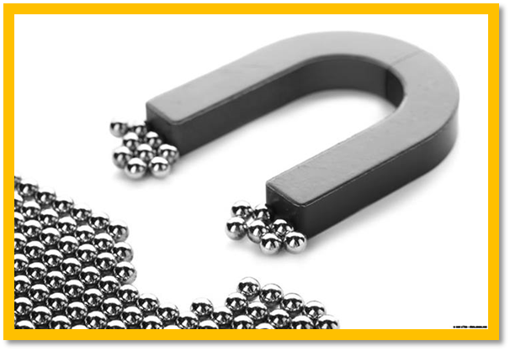
Polymer Chain Bonds
Like magnets, the bonds between molecules can be weak or strong. Some molecules can be pulled apart easily, while others take more energy to separate. Polymer chains are like this too, but are much longer than individual molecules.
A small amount of stickiness between molecules can add up to a whole lot of stickiness in long polymer chains. When the chains stick together strongly, it can be very tough to pull them apart.
If the chains are straight, stiff, and lined up close to each other, it can be hard to pull them apart. A great example of this is cellulose in wood. Cellulose chains lay closely next to each other, straight and sticky, helping trees to grow strong and tall.

Slide 12
Polymer Chain Speeds
Imagine that you are a preschool teacher and you need to get your students from the classroom to the playground. The quickest way to get them there would be to yell, “Everybody run to the playground!"
Some kids would run faster than others, and some might run off and never get there! While that might be a lot of fun for the kids, what could you do to make sure they all arrive at the same time? Try having them hold hands while going to the playground!
This way, the kids who want to run fast might pull forward a bit, and the kids who want to go into the woods might pull sideways, but they will all eventually arrive at the playground together!

Slide 13
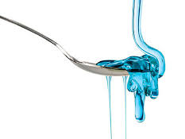
Polymer Chain Speeds
We can see this same effect happening when polymers dissolve in a liquid. The long chains move around so slowly that they make the solution flow much slower. The longer the chains, the slower the flow.
If we measure how long it takes for a polymer solution to flow, we can learn more about how long the polymer chains are.
The longer something takes to flow, the more viscous it is. This property is called viscosity.

Slide 14
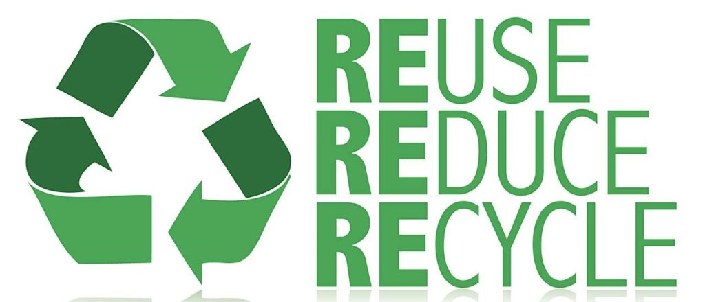
The Good and Not So Good
of Polymer Production
Most polymers will last a very long time, which is good especially if you use them to make clothes, jars, and even furniture. But it is not so good when polymers get thrown away. Some polymers are easier to recycle than others. It is important to recycle the polymers that we can, like single-use water bottles, so that landfills do not get filled up as fast.
Most polymers are safe and non-toxic which is good. However, the monomers that are used to make polymers are often toxic or smelly. That means that the companies producing polymers need to be very careful not to let the monomers get out before they are made into polymers.
Companies also have to consider what people want to buy. Many people prefer the look and feel of a heavy ceramic mug, or the beauty of a table made from real wood. So it doesn't look like we'll have an all-plastic world anytime soon!

